Slide 1

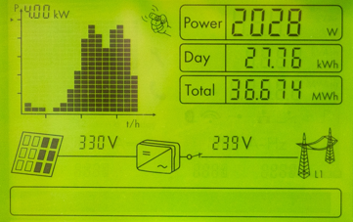

Solar Power in Australia: The current state of the nation
By:
Dale Currigan
Helen Amin
Rajesh Nair
Ray Camo

Slide 2

Introduction – Summary

Slide 3

Background
Home Solar energy has experienced rapid growth in Australia in the last 10yrs
It is a clean, renewable form of energy ideally suited to our favourable climate
We sought to develop an interactive platform to analyse past and future trends in the Australian Home Solar Energy industry

Slide 4
Questions
Which areas of Australia have been the best adopters of solar? Where is there unmet potential?
What factors affect conversion to solar power? In particular household income and the amount of federal government rebate received?
What have been the trends over time?
Potential targets for this data platform:
Government
Solar Installation Industry
Consumers
Notes:
Solar photovoltaic (‘solar power’) generated 3.1 per cent of Australia’s electricity in 2016-17, the majority of which came from small-scale rooftop installation. More than two million, or 21 percent, of Australian households now have rooftop solar, with a combined capacity exceeding 10 GW. However, there remains huge potential on Australia’s remaining roofs, for the expansion of solar power, especially given our climate.
Federal solar incentives and rebates for solar installation have led to a rapid adoption of this technology in recent years. However, the factors that that lead to consumers adopting this technology, and how that might inform future measures to increase solar, remain less clear.
Aims
Create a SQLite database of current and historical data, broken down by postcode, containing solar power installations, power generation, and factors that may influence the uptake of solar (e.g. household income, federal government solar rebates).
Use this database to create a series of interactive data visualisations that describe the current state of home solar in Australia, as well as identifying areas of unmet potential and factors that may influence homeowner’s willingness to adopt this technology.
Rationale
Potential applications of this project could include:
At a government level, allow the analysis of the rebate schemes success, and direct future initiatives and renewable energy policy.
At the individual household level, allow consumers to see how their suburb compares to the nation and how solar has changed over time. Such information could promote further adoption of solar and could be used as a marketing tool

Slide 5
Data Sources
Australian Clean Energy Regulator – 2001-2021 Small Scale Solar Installations Australia
Australian Bureau of Statistics. Taxation statistics dataset
Australian Clean Energy Regulator – Postcode rebate zone ratings
Australia – mean income by state – (www.statista.com)
GeoJSON for Australian Suburbs. Available at: https://github.com/tonywr71/GeoJson-Data/blob/master/australian-suburbs.geojson
Australian Database of Postcode and Suburb data. Available at: https://www.matthewproctor.com/australian_postcodes

Slide 6

Data Preparation

Slide 7
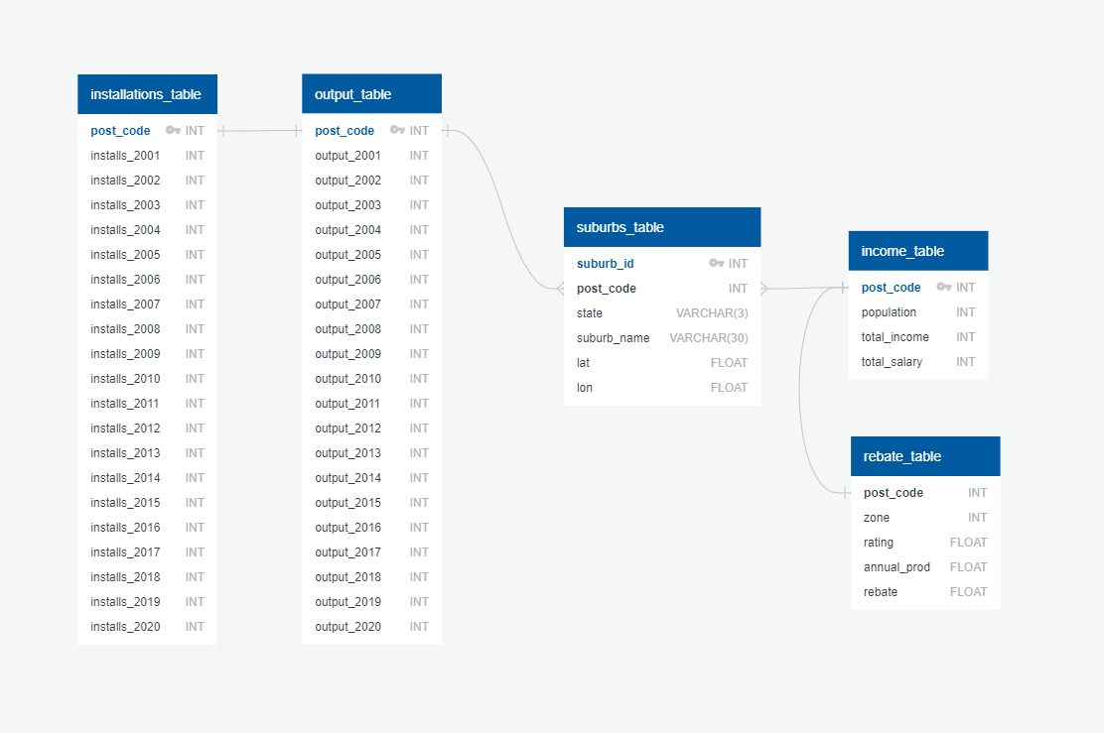
Data Cleaning
ERD

Slide 8
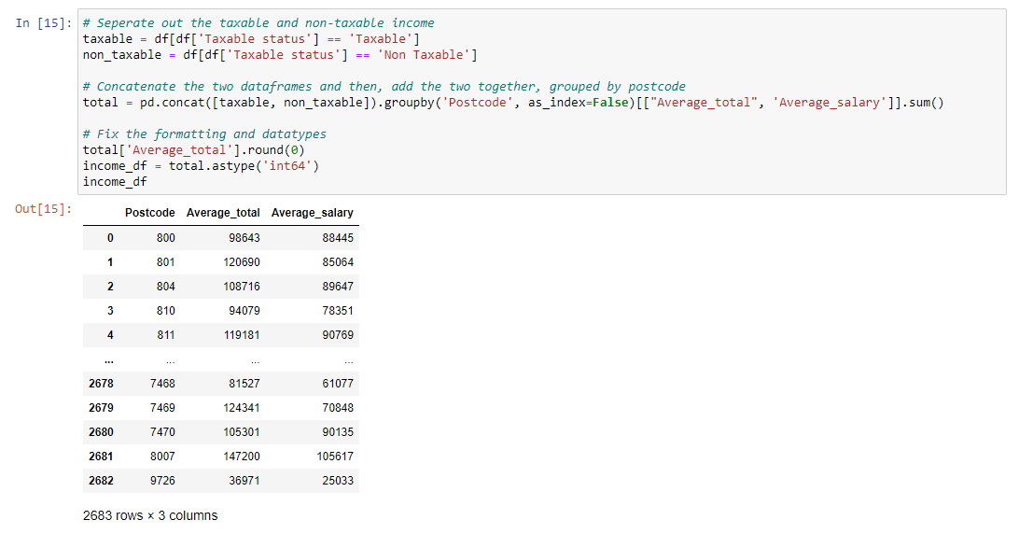
Data Cleaning
Tables created and cleaned

Slide 9
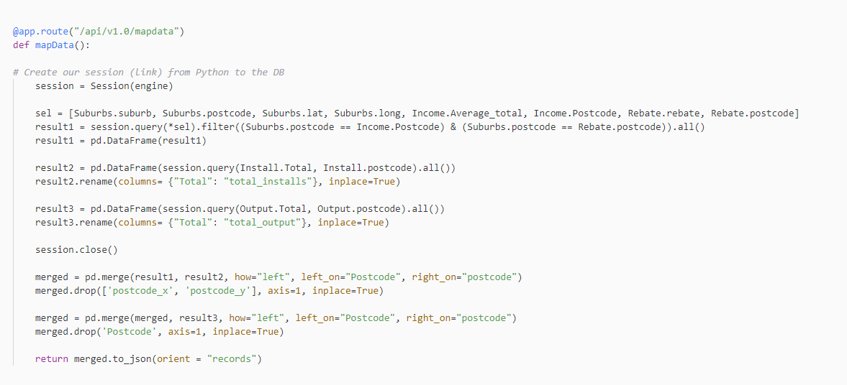
API Creation Process
SQLite Database Created (via SQLAlchemy)
Creations of API routes using Flask for each visualisation to query database for required data
Code example:

Slide 10
Site Structure

Slide 11
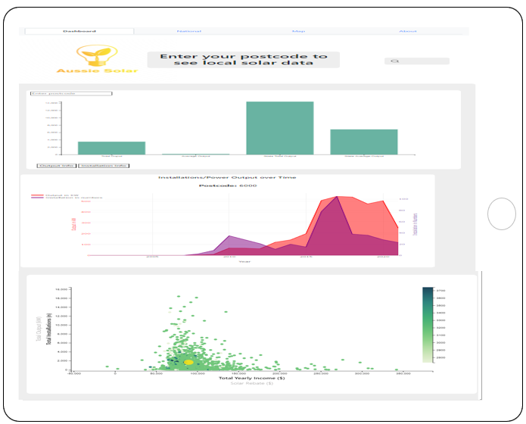
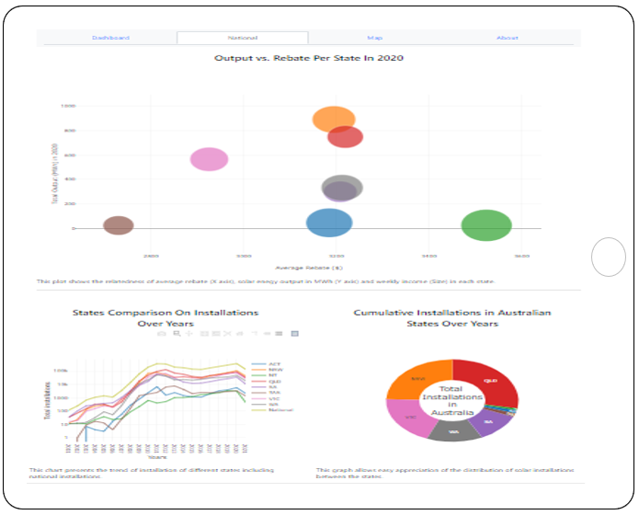
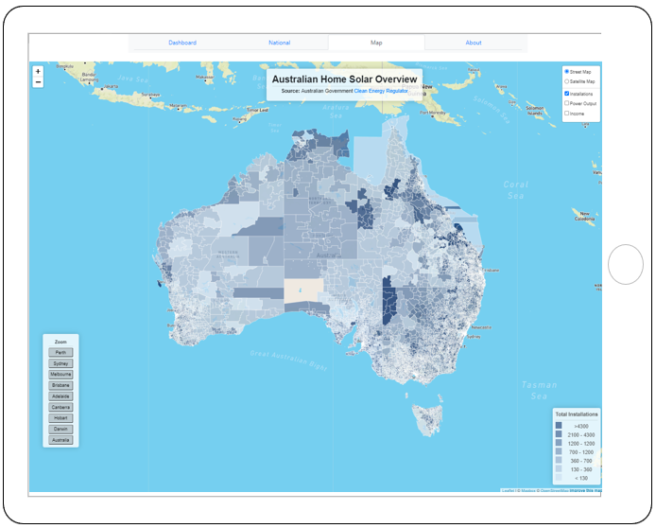
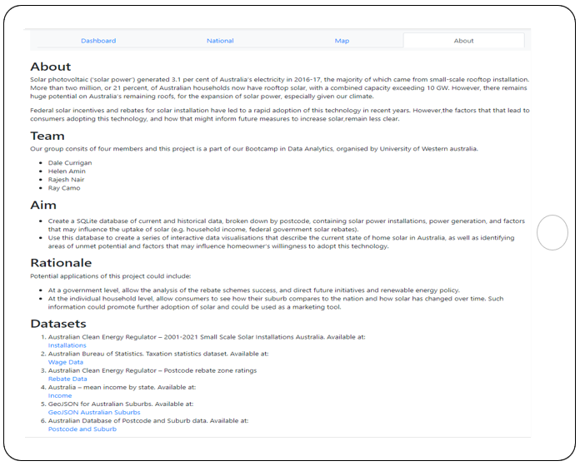

Slide 12
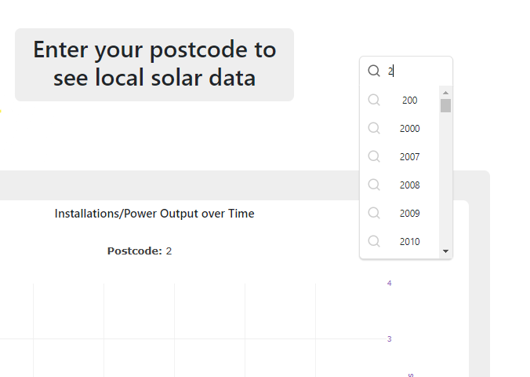
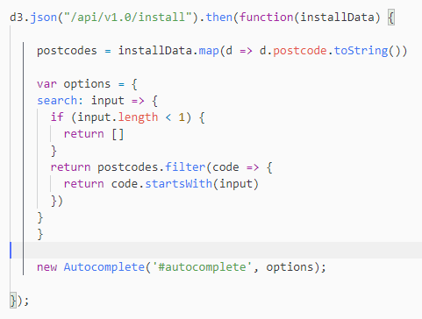
Autocomplete Library
Additional JavaScript library ‘autocomplete’ used for the search input field
Links the users input text to suggest entries present in the database

Slide 13
Data Visualisations

Slide 14
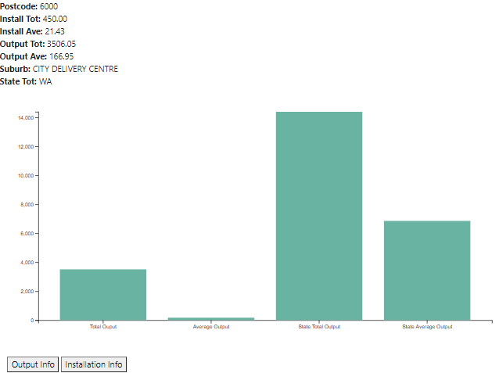
Post Code Bar Chart
D3 bar chart with dynamic information about the filtered postcode
The chart contains both total and average output for each postcode comparing them with state total and average output.

Slide 15
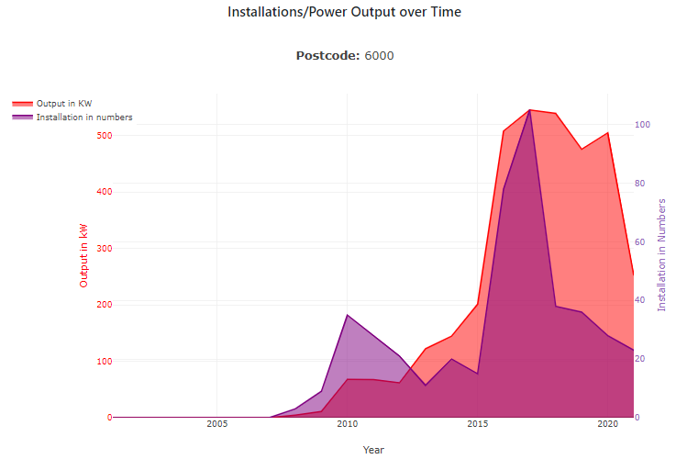
Installations/Power Output over Time
Plotly Line Chart
Shows Installations and output in each suburb at the same time
Large spike in installations particularly in the last 5 years

Slide 16
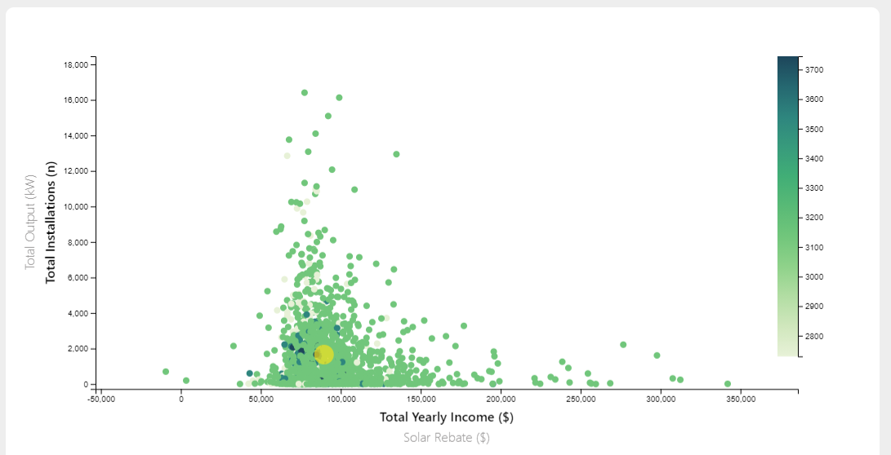
Income/Rebate vs Installations/Output
D3 Scatter plot with dynamic axes
Heatmap displays a third variable
Flashing indicator for currently selected suburb
Shows the highest uptake of solar in the $75000-$125000 income range

Slide 17
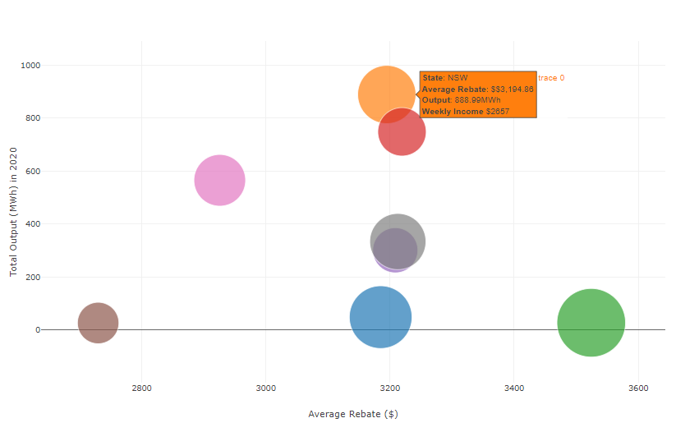
Output vs Rebate per state in 2020
Plotly bubble chart
Shows the relatedness of average rebate (X axis), solar energy output in MWh (Y axis) and weekly income (Size) in each state
Comparing states, NT with higher rebate and weekly income have less output(MWh) in contrast of highest output of NSW considering it’s middle range rebate and income
Population may be another explanatory factor

Slide 18
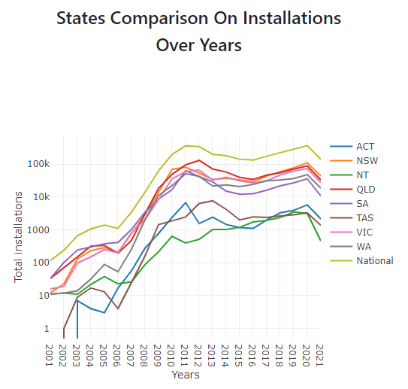
State Installation Comparison Over Time
Plotly line chart
Demonstrates a similar trajectory of solar adoption across the country, but with some states having performing better than others
Population may be another explanatory factor

Slide 19
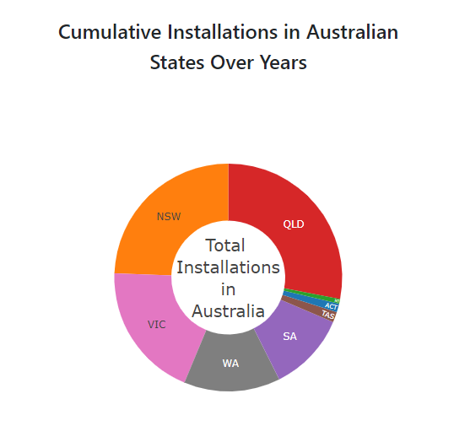
State Total Installation Comparison
Plotly donut plot
Allows easy appreciation of the distribution of solar installations between the states
Hovering the mouse on each state in the graph shows the percentage of installation in correspondent state

Slide 20
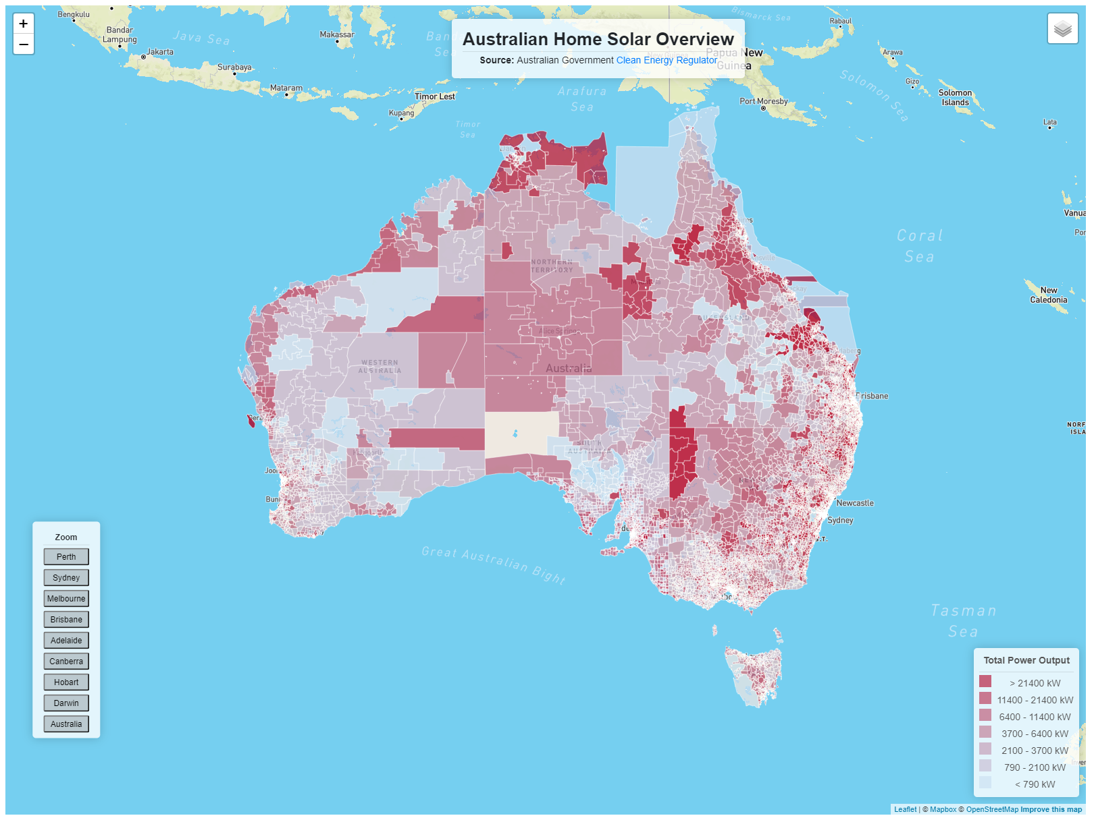
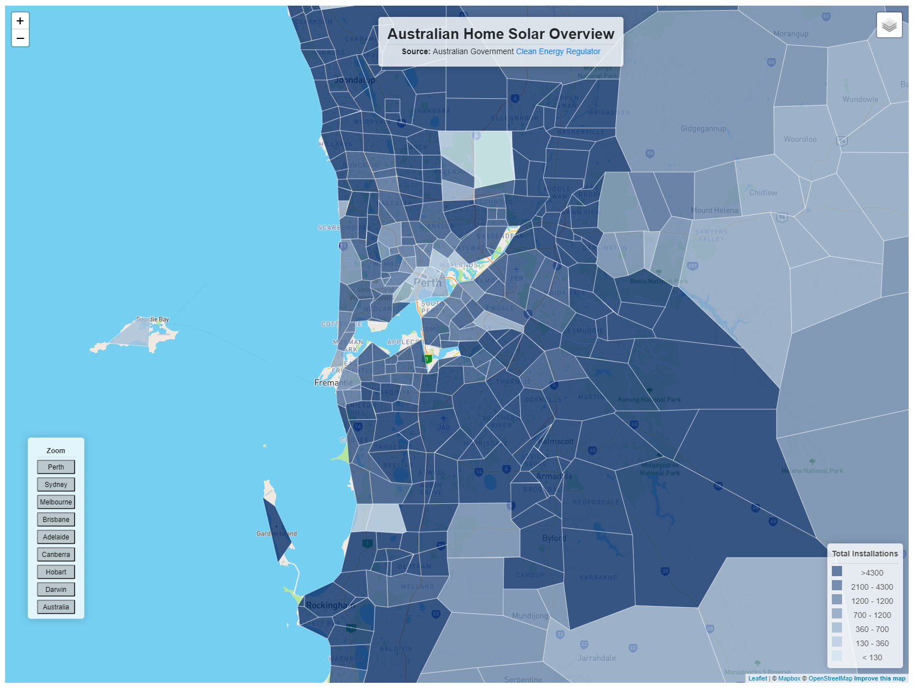
Choropleth Map
Choropleth map created using GeoJSON data of Australian Suburbs combined with Leaflet Choropleth package
Layers added for installs, output and income.

Slide 21
Summary and Conclusions

Slide 22

Conclusion
Analyzing the trend of using solar energy can help both government and Solar installation industry to identify hidden factors affecting this industry and assist them to make business-critical decisions to improve this trend

Slide 23
Limitations and Further Study
Limited source of Australian datasets (like no historical rebate datasets available)
Next step is to add population and solar radiation info to our analysis as more factors seems to be involved in trend of using solar energy

